Slide 1

Slide 1
TCS Hackathon
Credit Default Predictor

Slide 2




The Team
Meet Our Team
Saket Garodia
Vivek Sahoo
Shubham Gupta
Somil Saxena
Ex Analytics Associate -Edelweiss Financial Services
Software Engineer - Oracle
MBA – IIFT Delhi
Comp Sc – NIT Calicut
Love reading and backpacking
Ex Goldman Sachs
B.Tech from Manipal Institute of Technology
Loves dabbling with Standup comedy
Ex Data Analyst at Citibank
Ex Software Engineer at Nokia
B.Tech from IIT, Madras
Love data science, machine learning
B.Tech in Computer Science and Engineering
Love sports and watching Sci-Fi Movies

Slide 3

Contents
Problem at a glance
Project LifeCycle
Variables
Data Preparation and Visualization
Predictive Modelling
Model Interpretation and further pipelines
Appendix and codes

Slide 4






Slide 2
Problem at a glance
Data Source
Data Set Size
150,000
Problem :
Improve on the state of the art in credit scoring by predicting the probability that somebody will experience financial distress in the next two years
Use Data Mining to learn customers leading to increase in Business
What bank has to do reduce default and improve its business??
Well, vast datasets.
Now, we have to come up with a model which can be useful for the banks
Efficiency
Data Mining Black Box
Time

Slide 5
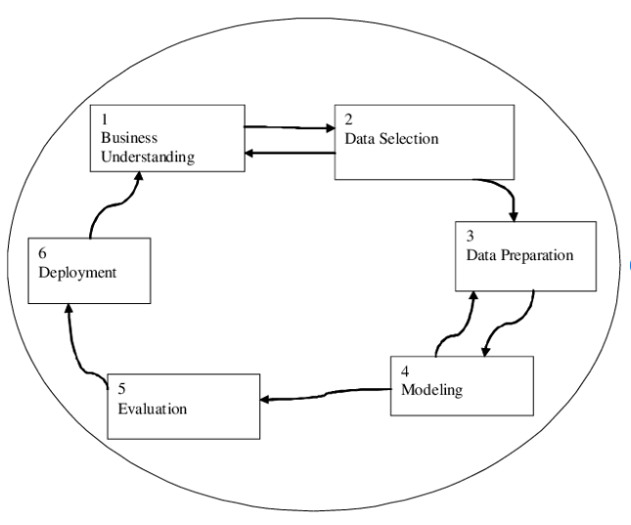

Data mining black box
Understanding the consumer banking landscape
Determining the business verticals that could leverage our Credit Risk Model
Understand, visualize and prepare it to feed into machine learning models
Building a model to predict chances of delinquency in the next 2 years
Very important to look back at every step

Slide 6


Slide 2
Variables
Dataset
Consumer spending behaviour
Debt ratio
Monthly Income
Number of Real Estate Loans or Lines
Revolving Utilization of Unsecured loans
Number of open credit lines and loans
Number of times (30-59 days) past due
Number of times ( 60-89 days) past due
Number of times 90 days past due
Consumer Characteristics
Number of Dependents
Age
2

Slide 7


Slide 2
Albert Einstein said,
I Would Spend 55 Minutes Defining the Problem and then Five Minutes Solving It
DATA PREPARATION

Slide 8
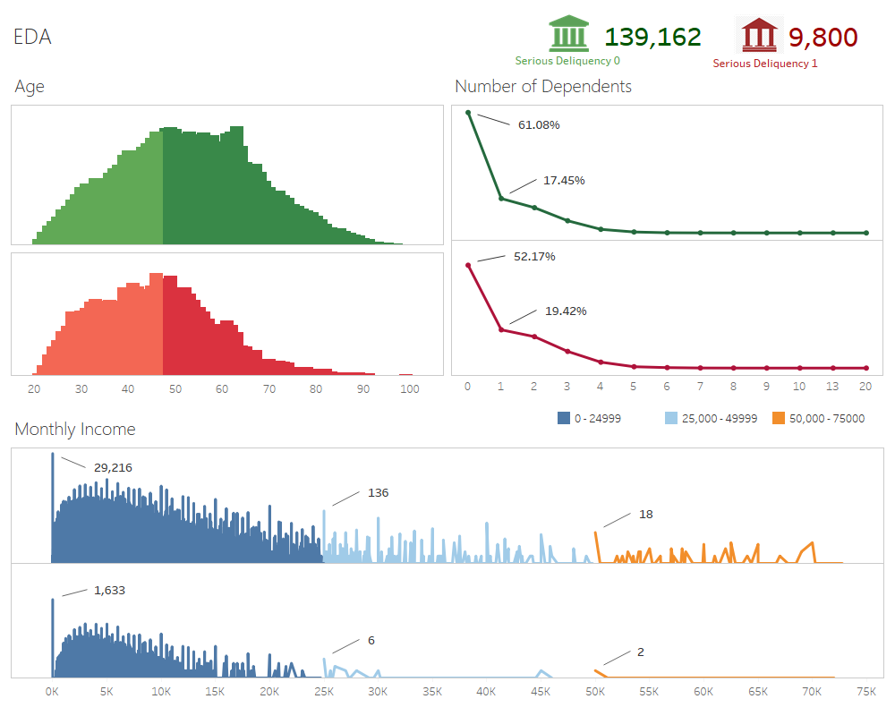
Slide 2
Exploring the variables
2

Slide 9
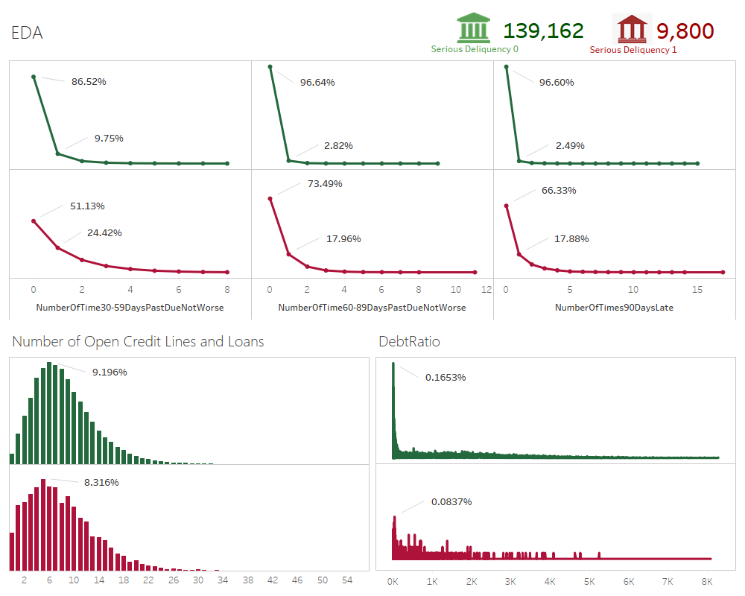
Slide 2
Exploring the variables
2

Slide 10
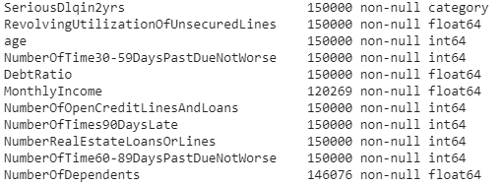
Slide 2
DATA PREPARATION
Next, we explored the distribution of all the other variables when the monthly income is null and not null
Total customers 150,000
Monthly Income | Var1 | Var2
Null
Null
Monthly income has 20% missing values
No of Dependents has 3% missing values
Monthly Income | Var1 | Var2
Not Null
Not Null
Result after describing the data
2

Slide 11
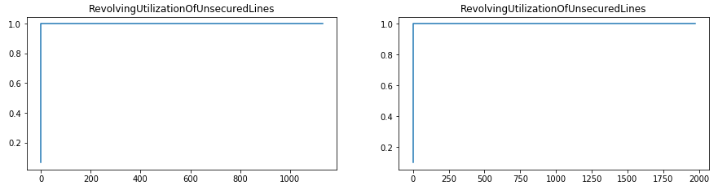
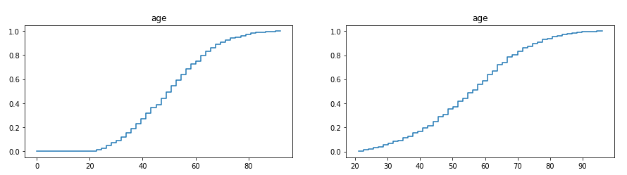
Slide 2
DATA PREPARATION
Monthly Income = not null
Monthly Income = null
2

Slide 12
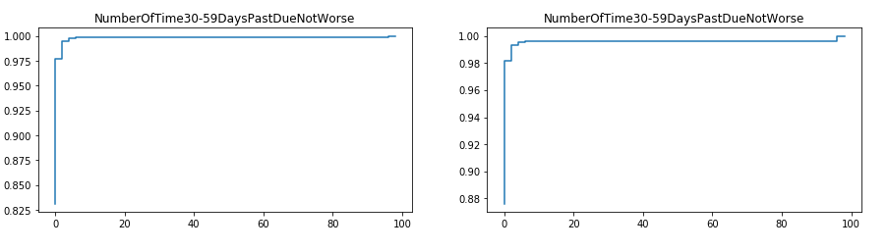
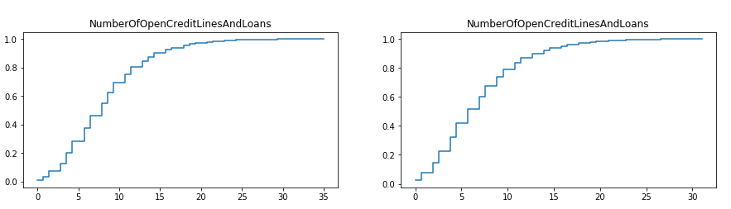
Slide 2
DATA PREPARATION
Monthly Income = not null
Monthly Income = null
2

Slide 13
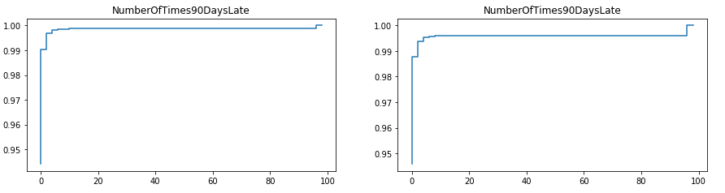
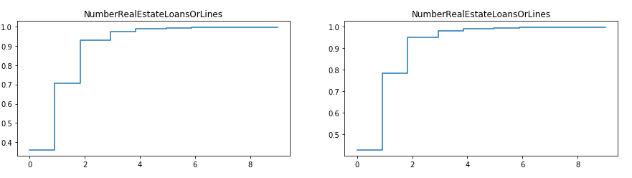
Slide 2
DATA PREPARATION
Monthly Income = not null
Monthly Income = null
2

Slide 14
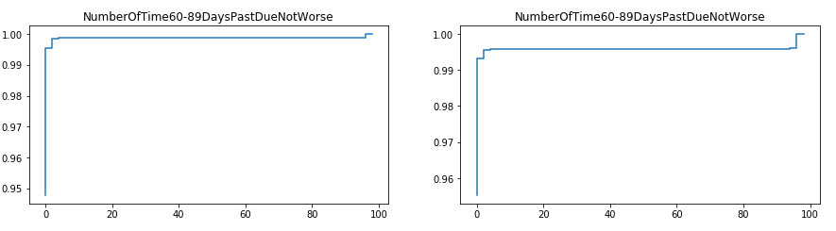
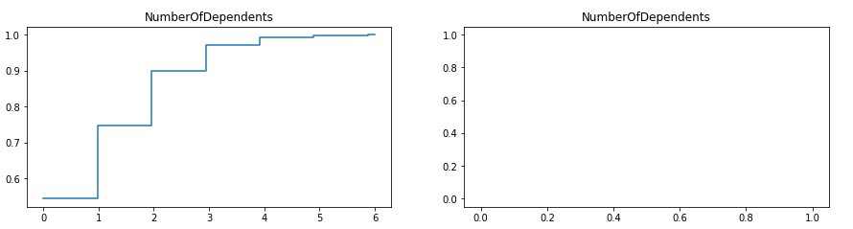
Slide 2
DATA PREPARATION
Monthly Income = not null
Monthly Income = null
2

Slide 15
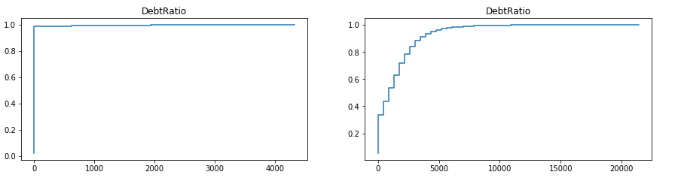
Slide 2
DATA PREPARATION
Monthly Income = not null
Monthly Income = null
Analysis from distributions ?
The Monthly income values which have ‘null’ values have different corresponding DebtRatio distribution compared to ‘not null’ values.
Result : Debt Ratio distribution can help in imputing null values of monthly income
2

Slide 16
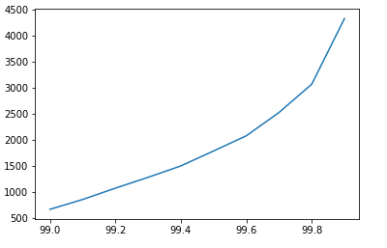
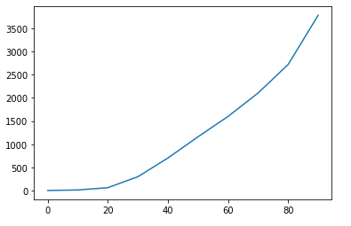
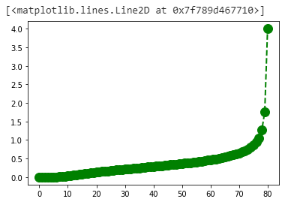
Slide 2
DATA PREPARATION
99-100 percentile
0-100 percentile
Distribution of Debt_ratio
Deeper analysis
Result : Missing income will have the same distribution as the top 1% debt ratio, so we will impute the missing income with the missing income for the top 1% debt ratio
We got 0.2391667, so imputing with 0. Its intuitive too,
high debt_ratio implies Less Income
Note : For number of dependents, there’s the same distribution of the variables when they have null and non-null values, so imputing with the median which is 0

Slide 17
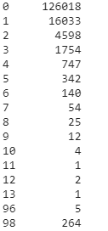
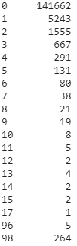
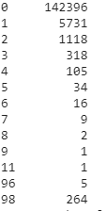
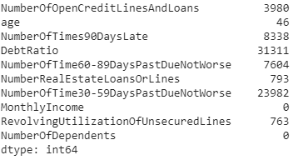
DATA PREPARATION
Outliers analysis
Boxplot outlier analysis
Values > 1.5 IQR
NumberOfTime30-59DaysPastDueNotWorse
NumberOfTimes90
DaysLate
NumberOfTime60-89DaysPastDueNotWorse
Almost 40% of the data have some outliers, so we cannot remove them all, lets delve deeper
Result : All these 3 variables have most of the value below 20 except 96 and 98 that occur 5 and 264 times in all the 3 datasets. There might be some error or maybe an actual data but anyways a outlier
We decided to impute those values with 20
In a similar fashion, we capped NumberRealEstateLoansOrLines to 30 and NumberOfOpenCreditLinesAndLoans to 40

Slide 18
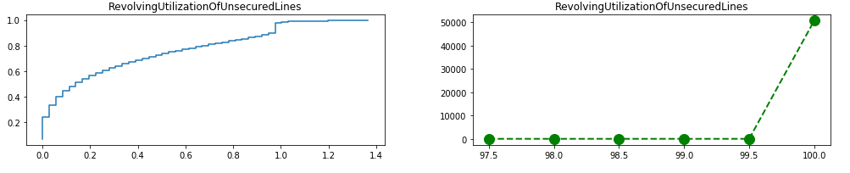
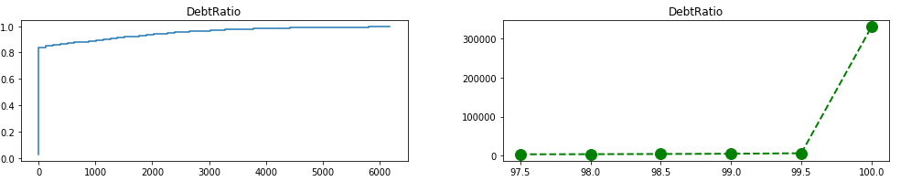
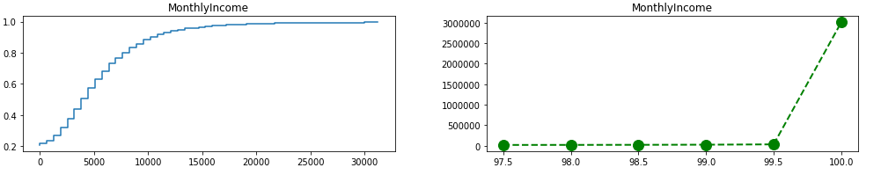
DATA PREPARATION
Result:
For these 3 variables, after looking at the ECDF and percentile plots its clearly evident that the values shoot up after the 99.5th percentile
Solution: We removed top .5% values for all of these.
In 150,000, .5% wouldn’t matter much and outlier removals and capping is a must to generalize the datasets else it might overfit

Slide 19

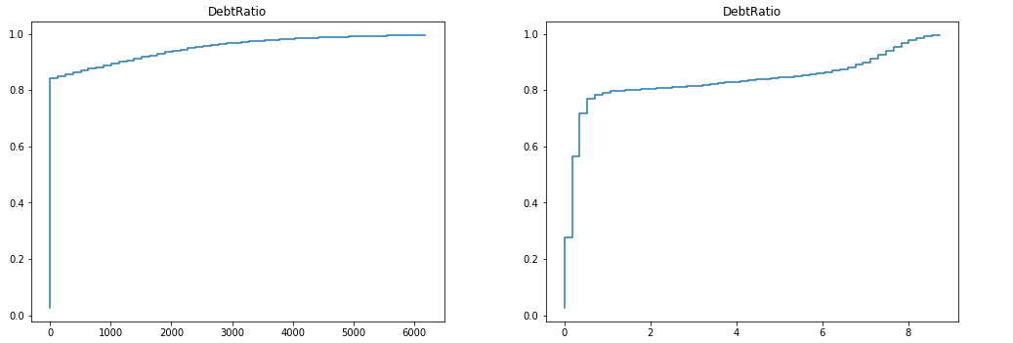
DATA PREPARATION
On our final step, we just smoothened our debt ratio column so that the machine learning models handle it well, since the ECDF was jumping after some low values.
Before smoothing
After smoothing

Slide 20

“As data piles up, we have ourselves a genuine gold rush. But data isn’t the gold. I repeat, data in its raw form is boring crud. The gold is what’s discovered therein.”
― Eric Siegel, Predictive Analytics: The Power to Predict Who Will Click, Buy, Lie, or Die
PREDICTIVE MODELLING

Slide 21




PREDICTIVE MODELLING
Clean data
Only 7% of our training data has Serious Delinquency as 1
It’s a supervised classification problem
Challenge?? Unbalanced dataset
Intuition before model building : We cannot chose models based on accuracy
Why? Even if we build a dummy model that predicts 0 for any new dataset it will have a accuracy of 93% because the chance of delinquency is only 7%
Confusion matrix for dummy model
 | Predicted - | Predicted +
Actual - | 34749 | 0
Actual + | 2492 | 0
Conclusion: We will look for other metrics like AUC, Precision, Recall to build the best model

Slide 22
PREDICTIVE MODELLING
Model 1
Analysis
Model 1+tuning
Analysis
Hyperparameters Tuning
Model 2
Analysis
Model 2+tuning
Analysis
We used K-fold validation to train and test before checking on the actual test set
Use all the best models to create a final model

Slide 23
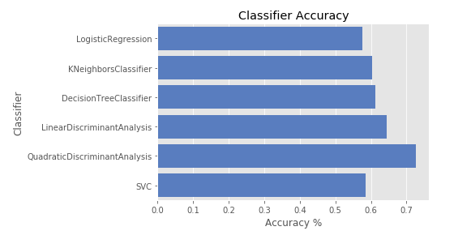
PREDICTIVE MODELLING
11 predictor variables
Tested if we can compress into a few variables using PCA
Step 1:
Result : PCA couldn’t explain the variance just using 2-3 principal components
So, taking all variables
Step 2 : Built different available classifier models using k-fold validation
Logistic Regression
K- Neighbors Classifier
DecisionTreeClassifier
SVC
Linear Discriminant Analysis
Quadratic Discriminant Analysis
Result : These models independently didn’t perform very good based on AUC score

Slide 24
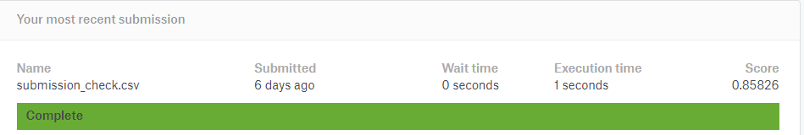


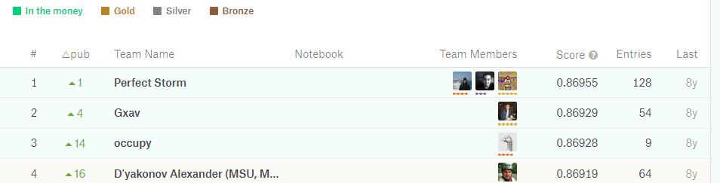
PREDICTIVE MODELLING
Step 3: Used one of the most powerful machine learning libraries – Ensemble models
Random Forest
Gradient Boosting gave us an amazing AUC of .85826 on Kaggle’s test set
Why ensemble is always better when there is no infrastructure constraint?? Because it reduces bias as well as variance by taking the power of many models and improving the errors of previous ones

Slide 25
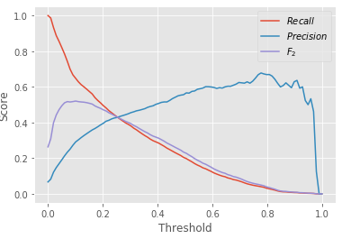
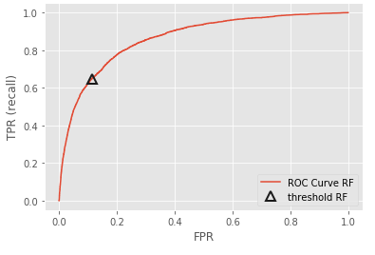



PREDICTIVE MODELLING
Deeper Analysis of our best model – Gradient Boosting
Confusion Matrix
 | Predicted negative | Predicted positive
True negative | 41527 | 470
True positive | 2399 | 604
Precision = .56
Recall = .20
20% of the people in the test set who actually committed a serious delinquency were classified as people who could commit
56% of the people in the test set for whom the model predicted as highly probable for a chance of commiting serious delinquency did actually commit
How can the model be useful to business?

Slide 26
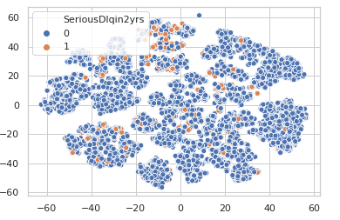
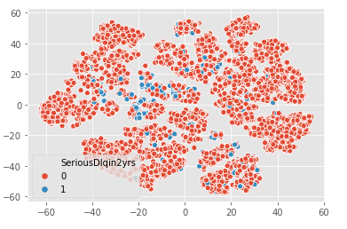
PREDICTIVE MODELLING
Distribution on 2-dim using 11 features
Now, we tried a deep learning technique Autoencoder to convert the 11 features to 50 features
We can get an intuition that the distribution of the datasets of 1s and 0s are so closely distributed.
Result : The distribution is still very close

Slide 27
Slide 2
Interpretation of the resulting metric
High risk appetite
Cares less about recall, so focus on precision. Why? Low appetite for default
Increase the probability threshold to flag as a defaulter
Low risk appetite
Needs more recall value. Why? Low appetite for default
Decrease the probability threshold to flag as a defaulter
Precision vs Recall tradeoff value

Slide 28
Slide 2
Using model in other pipelines
One machine learning pipeline ( or Black box ) may not directly be used to affect decision making
Other signals
Our blackbox
Upstream signals
Blackbox 2
Insurance / Cross selling / Pricing
Customers data
Direct usage in loan department

Slide 29
Thank you
Questions ?

